Slide 1
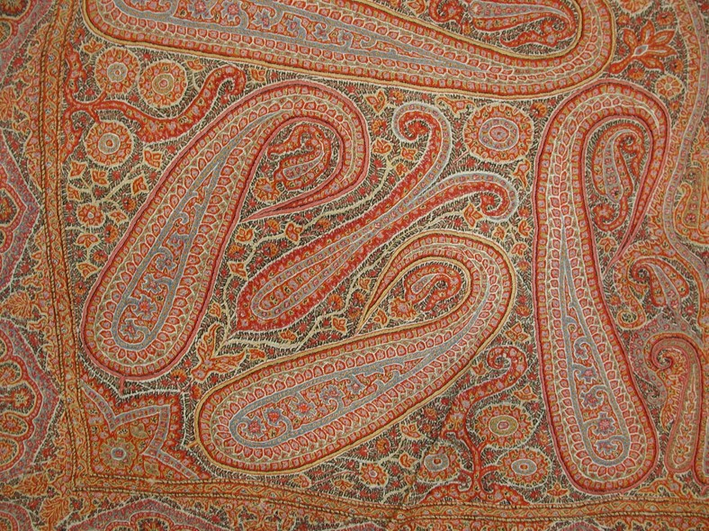
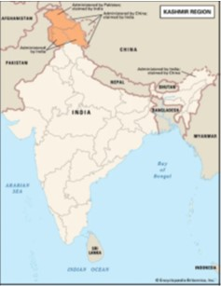
Lesson Planning Overview: Kashmiri Shawl
Scholarship
This lesson is planned using extracts from Dr Sheilagh Quaile’s forthcoming book, A Transnational History of Paisley Design.
Other text is drawn from:
Sheilagh Quaile, ‘Cashmere Shawls,’ Smarthistory: The Center for Public Art History, 22 Feb. 2021, smarthistory.org/cashmere-shawls/.
Curriculum Themes
The Kashmiri shawl helps explore:
Global trade and globalisation
Industrial revolution and empire
Impacts of empire in Britain
Cultural exchange and imitation
Cross-curricular links to art, design, and technology (e.g. textile technology, computing science, technology and societal change)
Period & Place
The Kashmiri shawl originates in the Kashmir region of the Indian subcontinent. Today, Kashmir is a disputed region: India and Pakistan both claim Kashmir in full, but different parts of Kashmir are administered by India, Pakistan, and China.
Objects of Empire
Detail of an embroidered wool shawl attributed to Kashmir, mid-19th century.
The Metropolitan Museum of Art, New York.
Object Summary:
Kashmiri shawl cloth has been produced since at least the mid-15th century, but the industry was boosted in the 16th century by patronage of the Mughal emperors of northern India. This cloth was traded throughout Asia, where it had a wide range of uses. In the late 18th century the cloth became popular in Europe, where it was worn mostly by women as a shoulder mantle, or ‘shawl’. European manufacturers, including those in Paisley, Scotland, then reproduced Kashmiri shawl patterns, often using cheaper fibres and new industrial technologies, which allowed them to sell their shawls at lower prices and take over some of Kashmir’s markets. At the same time, the British restructured trade in Asia, which made Kashmiri shawl manufacturers dependent on European consumers. The Kashmiri economy was damaged when the European shawl fashion declined in the 1870s.
Lesson Ideas
A potted history of the Kashmiri shawl
Guided reading of Dr Sheilagh Quaile’s research on Kashmiri shawls and their imitations, followed by 10 questions.
Watch videos about the Jacquard loom by Macclesfield Museums and National Museums Scotland, followed by discussion.
‘Close looking’: a guided comparison of some Kashmiri and Paisley shawl
Teacher-led discussion/writing: What can the story of the imitation Kashmiri shawl tell us about the industrial revolution in Britain? What can it tell us about empire?
Sequencing & Pairing
This lesson could be used to highlight the underacknowledged role that Asian knowledge played in Britain’s industrial revolution. It is also suited to studying impacts of the British Empire.
As well as history / social science classes, this lesson could be used in classes on art, design, and technology. The shawl helped popularise the buta or ‘paisley’ motif in European design, and one of the looms that Europeans used to imitate Kashmiri shawls (the Jacquard loom) is an antecedent to modern computers (see this video from Macclesfield Museums, https://www.youtube.com/watch?v=pzYucg3Tmho).
Notes on teaching…
This session was designed by Dr Sheilagh Quaile, expert on Paisley. Do let us know if you try it in the classroom!
Created by Dr Shelia Quayle

