Slide 1
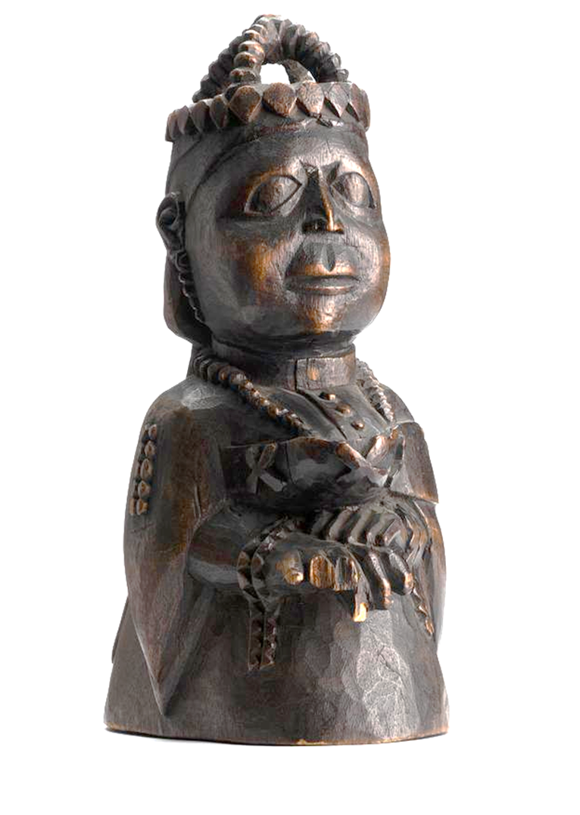
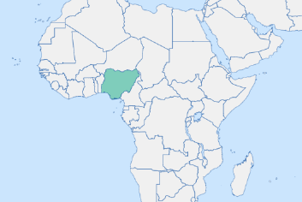
Lesson Planning Overview: Yoruba Queen Victoria
Scholarship
This lesson was planned using:
Zachary Kingdon; ‘The Queen as an Aku Woman?: Reassessing “Yoruba” Queen Victoria Portrait Figures.’ African Arts 2014; 47 (3): 8–23
Further reading and links:
https://www.horniman.ac.uk/object/1990.138/ click on Commentary
https://www.rct.uk/collection/83827/queen-victoria
Curriculum Themes
This object helps explore:
Indigenous voice
Colonial rule
Enslavement
West African culture, art and heritage.
The dynamic between British royalty and colonised people.
Missionaries.
Missionary education.
Period & Place
The statue originates from West Africa, likely the Saro people of Nigeria and dates from the time of her Golden (1887) or Diamond (1897) Jubilee.
Objects of Empire
Carved wooden figure of Queen Victoria in regal dress, Horniman Museum, 1990.138, Nigeria, late nineteenth century.
Object Summary:
This carving of Queen Victoria was made in the late nineteenth century, inspired by photographs of the queen which circulated around the empire including West Africa after her jubilee in 1887. It conforms with traditions of Yoruba sculpture, where the head is enlarged to indicate wisdom. Feet are carved under the dress. Many were collected by the British but no mention was made of their makers. Zachary Kingdon has argued that they were commissioned by the Saro community in Nigeria (Saro = Nigerian name given immigrants from Sierra Leone). Many of these returnees were Aku - formerly captive Yoruba who had been freed to Sierra Leone by British war ships policing after abolition in the Atlantic. Despite some poor treatment by British officials, many Aku revered and were loyal to Queen Victoria and were Christians after missionary education in Sierra Leone.
Lesson Ideas
Getting started with a high quality image of the statue for students to annotate.
Following discussion, students write their impression of the Saro view of Victoria to come back to.
Develop with scaffolded questions to examine who made it, how, whether it was ‘positive/complimentary’ to address misconceptions.
Teacher exposition on West African art with visual examples of other pieces by way of comparison.
Reading an extract from Kingdon’s on reassessing Yoruba Queen Victoria with question prompts.
How has the view changed based on scholarship?
What can Yoruba Queen Victoria teach us about:
Relations with the Crown
Indigenous views of Empire
The role of missionary work
Sequencing & Pairing
This lesson pairs well with enquiries that seek to give voice to indigenous and colonised people as we see an indigenous view of Queen Victoria. This could therefore sequence well with other lessons that examine indigenous experiences and views.
This would also sequence well with an enquiry focusing on art and/or portraiture. This could be a full enquiry exploring empire through portraits.
The positive view of Victoria here is in part formed by the work of missionaries, which would make this a useful thread for a series of lessons on the impact or effects of missionary work on indigenous people and their relationship with Britain.
Notes on teaching…
This lesson was planned for KS3 Year 8 students. The enquiry that asks ‘How can material objects help us to understand Britain's role in the world?’ This lesson helps explore indigenous views of empire through art and is part of a wider study of West Africa.
By Sasha Smith (@SashaL_Smith)
For the Objects of Empire Project,
supported by The University of Lincoln

