Slide 1
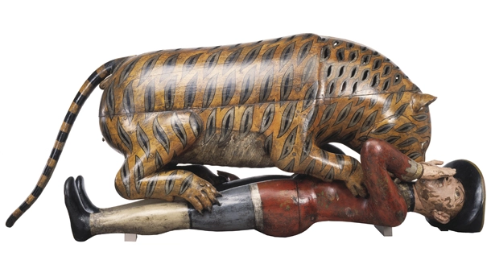
What can Tipu’s Tiger teach us about the British Empire?
Last lesson we learnt about… exploration of the South Seas and the Māori.
Big Picture: How can material objects help us to understand Britain's role in the world?

Slide 2
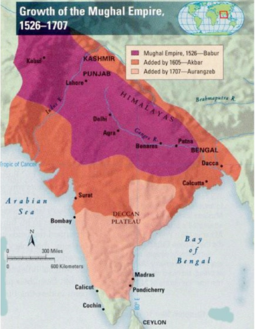
STARTER
What do we remember from last half term about the Mughals?
Notes:
Initial ideas, then green pen

Slide 3
What can Tipu’s Tiger teach us about the British Empire?
Watch the video and add details to each of the prompts in your booklet.
What did the first British in India travel there for?
What was the East India Company?
What did the East India Company trade in?
What did the East India Company create to control India?
Who was Robert Clive?
What was his attitude to controlling India?
What happened at the Battle of Plassey 1765?
What did the British EIC build in Calcutta?
What role did Robert Clive take on in India?
What does Paxman suggest about the impact of the East India Company for Britain and Empire?
Notes:
Prompts are in order of the video:
How did the British gain control of India? | History - Empire (youtube.com)
Rulers and ruled in the British Empire | History - Empire (youtube.com)
Can be followed up by a second video

Slide 4
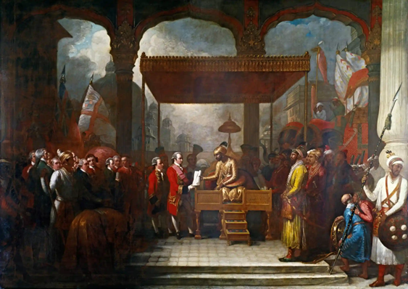
What can Tipu’s Tiger teach us about the British Empire?
How and why did the relationship between British traders and India change in the 18th century?
First, let’s examine the painting.
The painting, by Benjamin West was completed in 1818. It depicts the Conveying the Grant of the Diwani that had happened in 1765… over 50 years earlier. West was also the artist responsible for the Joseph Banks portrait.
Notes:
Can play longer if your class work well.

Slide 5
What can Tipu’s Tiger teach us about the British Empire?
How and why did the relationship between British traders and India change in the 18th century? Read the extract from William Dalrymple & answer in your booklet.
The painting shows a scene from August 1765, when the young Mughal emperor Shah Alam, exiled from Delhi and defeated by East India Company troops, was forced into what we would now call an act of involuntary privatisation. The scroll is an order to dismiss his own Mughal revenue officials in Bengal, Bihar and Orissa, and replace them with a set of English traders appointed by Robert Clive – the new governor of Bengal – and the directors of the EIC, who the document describes as “the high and mighty, the noblest of exalted nobles, the chief of illustrious warriors, our faithful servants and sincere well-wishers, worthy of our royal favours, the English Company”. The collecting of Mughal taxes was henceforth subcontracted to a powerful multinational corporation – whose revenue-collecting operations were protected by its own private army.
It was at this moment that the East India Company (EIC) ceased to be a conventional corporation, trading and silks and spices, and became something much more unusual. Within a few years, 250 company clerks backed by the military force of 20,000 locally recruited Indian soldiers had become the effective rulers of Bengal. An international corporation was transforming itself into an aggressive colonial power.
Using its rapidly growing security force – its army had grown to 260,000 men by 1803 – it swiftly subdued and seized an entire subcontinent. Astonishingly, this took less than half a century.
Notes:
Can play longer if your class work well.

Slide 6
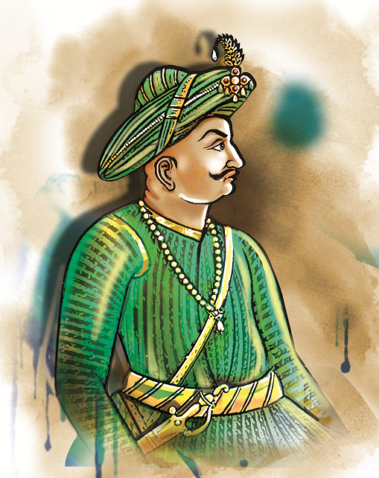
What can Tipu’s Tiger teach us about the British Empire?
Who was Tipu Sultan?
What was his reputation?
What was his relationship like with Britain?
https://www.youtube.com/watch?v=sK2qWXPqufE

Slide 7
What can Tipu’s Tiger teach us about the British Empire?
From our knowledge of Tipu, the East India Company, and the museum label, answer the first three questions:
What does Tipu’s Tiger represent?
Why a tiger?
Why the stripes?
Notes:
Tipu's Tiger (youtube.com) Useful video explaining the object

Slide 8
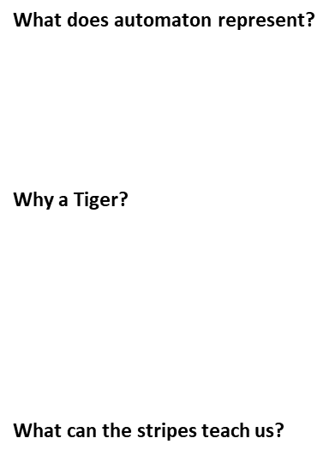
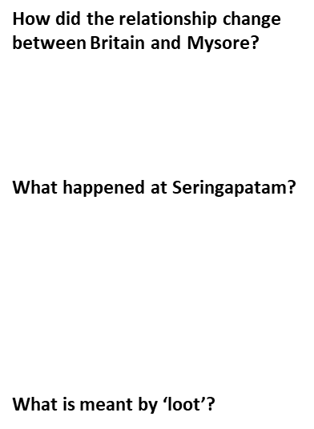
What can Tipu’s Tiger teach us about the British Empire?
Together we are going to answer the remaining questions through the story of Seringapatam. Listen carefully and completely the questions as I read.

Slide 9
Tipu Sultan was the ruler of Mysore, a kingdom in South India, from 1782-1799. In the late 18th century, Mysore came to blows with the British East India Company as they sought to extend British dominance in India. As an extension of tensions in European politics, Mysore received support from French allies, who sought to weaken British control of India. The Anglo-Mysore wars reached a culmination with the final British assault on Seringapatam, Tipu’s capital, in 1799. The battle was decisive, and the British were victorious. Afterwards, British soldiers searched for the body of the Sultan, who was found in a choked tunnel-like passage. Benjamin Sydenham described the body as: ‘wounded a little above the right ear, and the ball lodged in the left cheek, he had also three wounds in the body, he was in stature about 5 ft 8 in and not very fair, he was rather corpulent, had a short neck and high shoulders, but his wrists and ankles were small and delicate.’
The British army swept through the city, ruthlessly looting and pillaging. Their behaviour was reprimanded by Colonel Arthur Wellesley, later the Duke of Wellington, who ordered the ringleaders to be sent to the gallows or flogged. One of the prizes of the loot was what became known as ‘Tipu’s tiger’. This nearly life-sized wooden wind-up tiger is depicted towering over a European solder lying on his back. It was part of a wider collection of objects which Tipu commissioned, where British figures were attacked by tigers or elephants, or executed, tortured and humiliated in other ways.
Now housed in the V&A, within the tiger’s body an organ is concealed by a hinged flap. It can be operated by turning a handle. The handle also triggers a movement in the man’s arm, and a set of bellows expels air through a pipe inside the man’s throat, so he emits a noise akin to dying moans. Another mechanism inside the tiger’s head expels air through a pipe with two tones, producing a grunting sound like that of a tiger. The French cooperation with Tipu has led some scholars to believe that the internal mechanics may have been made by French workmanship.
An eyewitness of the discovery was shocked at Tipu’s arrogance: ‘In a room appropriated for musical instruments was found an article which merits particular notice, as another proof of the deep hate, and extreme loathing of Tippoo Saib towards the English. This piece of mechanism represents a royal Tyger in the act of devouring a prostrate European … It is imagined that this memorial of the arrogance and barbarous cruelty of Tippoo Sultan may be thought deserving of a place in the Tower of London.’
Tigers and tiger stripes were symbolic of Tipu Sultan’s rule. Everything he owned was emblazoned with this exotic wildcat. His throne was embellished with tiger head finials and tiger stripes were stamped on his currency. It became a symbol used to terrorise European enemies in battle. Swords and guns were marked with images of a tiger, bronze mortars were shaped like a crouching tiger, and men who fired lethal rockets into British troops wore tiger striped tunics. The British were well aware of the symbolism. After the Siege of Seringapatam, a medal was struck in England for every soldier who fought. It depicted a snarling British lion overpowering a tiger. After the treasures of Seringapatum were shared amongst the British soldiers according to rank, the automated tiger was returned to England. READ THIS SECTION AFTER THE NEXT TASK!!!

Slide 10
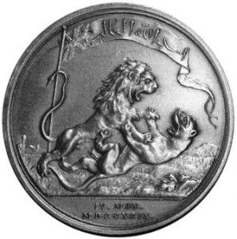
What can Tipu’s Tiger teach us about the British Empire?
This is the medal awarded to British soldiers after the siege of Seringapatam in 1799.
What do you think the image represents?

Slide 11
PLENARY
What can Tipu’s Tiger teach us about the British Empire in India?
In your answer, you should consider:
The nature and impact of British rule – how did they treat Indians?
The response within India to British rule – think about what the Tiger shows us.
The looting of Tipu’s Tiger and it’s place in the Victoria and Albert Museum, to this day.

Slide 12
Teacher notes – Object history – Tipu’s Tiger
Students should have listened to the podcast prior to the lesson and this is needed for the starter task.
This lesson will being together some of our prior learning on the Mughals, and feed into a theme across this SOL on the British role in India, and then contributing to the SOL at the end of Y8 on the partition of India.
Tipu’s Tiger is an amazing object for student to gauge the might of Tipu Sultan, his story, his pride (symbolism) and the resistance by Mysore.
The journey of the object allows students to see the defeat at Seringapatam and the subsequent looting of Tipu’s palace, along with the questions surrounding museum ownership.
Teacher note: there is a lot to get through today. Keep it pacey!
https://www.historytoday.com/archive/months-past/tipu-sultan-killed-seringapatam
https://retrospectjournal.com/2019/10/27/tipus-tiger-and-the-importance-of-visual-language/
Tipu's Tiger (youtube.com)

