Slide 1
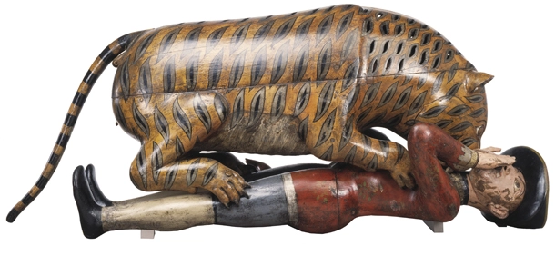
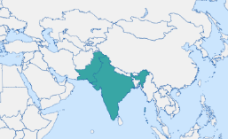
Lesson Planning Overview: Tipu’s Tiger
Scholarship
This lesson is planned using the following scholarship:
Sadiah Qureshi, ‘Tipu’s Tiger and Images of India, 1799-2010’ in S. Longair and J. McAleer (eds), Curating empire; museums and the British imperial experience.
Further reading:
Art Detective podcast by Dr Janina Ramirez, episode titled ‘Tipu's Tiger - with Sona Datta’.
Masala History podcast by Deepthi Murali and Manamee Guha, episode 3 titled ‘Tipu Sultan - The Tiger of Mysore’.
https://collections.vam.ac.uk/item/O61949/tippoos-tiger-mechanical-organ-unknown/
Curriculum Themes
Tipu’s Tiger helps explore:
Loot
War and conflict in empire
Museum collection & curation
The East India Company
Trade
Resistance
Period & Place
Tipu’s Tiger was looted in the siege of Seringapatam, present-day Srirangapatna, in 1799 during the fourth Anglo-Mysore war.
Objects of Empire
Tippoo's Tiger Mechanical Organ © Victoria and Albert Museum, London.
Object Summary:
'Tippoo's Tiger' was made for Tipu Sultan, ruler of Mysore in South India from 1782 to 1799.The tiger, a 1.78m-long wooden semi-automaton, mauls a European soldier lying on his back. Concealed inside the tiger's body, behind a hinged flap, is an organ which can be operated by turning the handle next to it. This simultaneously makes the man's arm lift up and down and produces noises intended to imitate his dying moans.Tigers and tiger stripes were part of the decoration of Tipu Sultan's possessions to proclaim his rule. The tiger was looted by the British from the music room of Tipu Sultan and was sent to East India House, the headquarters of the East India Company which housed a library and museum. The tiger soon became one of the most popular exhibits. The India Museum, as it became known, moved several times before parts of the collection, including Tipu's tiger, were transferred to the South Kensington Museum, later renamed the Victoria and Albert Museum.
Lesson Overview
Link to prior learning about world empires and Benin in particular. Knowledge retrieval of Benin Bronzes controversies to help set up discussions about museum collections and repatriation.
Discussion about how objects come to museums. Using guided reading from the BM website about routes to the museum to learn about different ways museums collect.
Discussion of objects known to students to see which routes those object took.
Study into where the objects we’ve studied come from and where students think they should go. Some of the answers are prepopulated for support with this.
What does the BM teach us about Britain’s role in the world today?
Sequencing & Pairing
The story of Tipu Sultan is an important part of the wider history of the British in India. The Anglo-Mysore wars help students to understand the role of a private company, the East India Company, in the creation of a colony. Tipu’s Tiger helps teach about resistance, so would pair well with an enquiry into resistance to British rule. It also pairs well with lessons about loot and museum curation.
In our enquiry, this lesson forms part of a sequence of lessons into the British Empire in India. It build on prior learning about the Mughal Empire and Indian kingdoms prior to EIC trade. It links to future lessons on the Indian Rebellion 1857, the swadeshi home movement, and later, the partition of India.
Notes on teaching…
This lesson was planned for KS3 Year 8 students. The enquiry that asks ‘How can material objects help us to understand Britain's role in the world?’
The visual appeal of this object made it a very popular lesson within the enquiry. Studying Tipu’s Tiger can be combined with a trip to the V&A and the South Asia collection. The V&A website included a video of the semi-automaton in use.
By Sasha Smith (@SashaL_Smith)
For the Objects of Empire Project,
supported by The University of Lincoln

