Slide 1
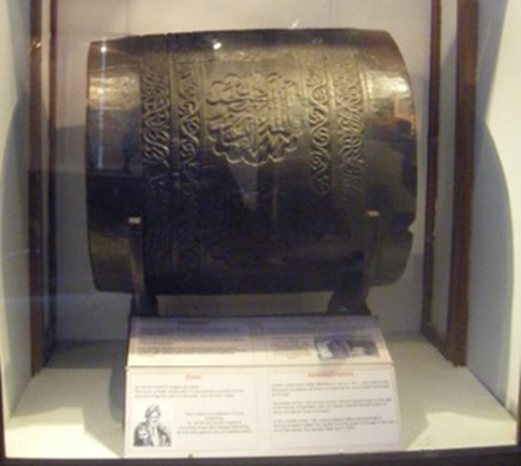
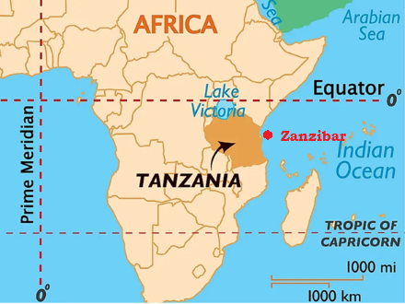
Lesson Planning Overview: The Ngoma (drums)
Scholarship
This lesson is planned using
Sarah Longair, Cracks in the Dome: Fractured Histories of Empire in the Zanzibar Museum, 1897 – 1964. Farnham, Surrey: Ashgate, 2015. ​
For further reading:
The shortest war in history: The Anglo-Zanzibar War of 1896 / Historical Association
Curriculum Themes
The Ngoma helps explore:
Pre-colonial histories of East Africa.
Contextualising pre-European and colonial countries.
Zanzibar trading location and the role of trade in Empire.
Power and the meaning of this object to leaders.
Scramble for Africa.
Links to different communities to linking to religion and Islam.
Period & Place
The Ngoma are from Zanzibar and were important symbols of power for the Swahili people ruled by the Mwinyi Mkuu
Objects of Empire
The ngoma in the Zanzibar museum in 2009.
Object Summary:
Ngoma (drums) were important symbols of power for the Swahili people in Zanzibar ruled by the Mwinyi Mkuu, a local leader. They were beaten ceremonially in times of war and their whereabouts were only known to a small number of people, as their power was so great. They were decorated with verses from the Qur’an. The Mwinyi Mkuu’s dynasty died out in the 1880s and Zanzibar became a British Protectorate in 1890. The British rulers were keen to acquire the drums, knowing of their political and cultural significance. First Minister Alexander Rogers succeeded, and displayed the drums in his new residence, but chose to denigrate them by using them as tables.​ The drums were then taken to the new Zanzibar Museum in 1925, and put on public display where the skins were removed after rumours that they were played a night by invisible drummers. Drums were brought out of the museum and played during the Zanzibar Revolution in 1964.
Lesson Ideas
Trace the story of the drum backwards to start in 1964 from the height of anti-imperial feeling.
Contrast them with similar objects, such as objects from across the Empire like the Akan Drum.
Compare to objects of significance to Britain to contextualise the significance of objects with this much meaning being taken.
Ghost storytelling device with the skin removal.
Annotating to consider a ‘spot the difference’ style activity of it in its difference uses.
Sequencing & Pairing
This lesson would pair well with the Akan Drum to study drums of Empire and their changing meanings. It could also sequence with musical objects and the sounds of Empire, with links to Tipu’s Tiger and Akan Drum .
‘If objects could talk’ stories of Empire could be an approach to considering this object. It could also link to Islamic histories and bringing together the pre-colonial world.
Notes on teaching
These lesson ideas were devised as part of the ‘Teaching Empire through Material Culture’ HA course. Do let us know if you try any of them.
Created by the ‘Teaching Empire through Material Culture’ Historical Association course group, led by
Dr Sarah Longair and Sasha Smith

