Slide 1
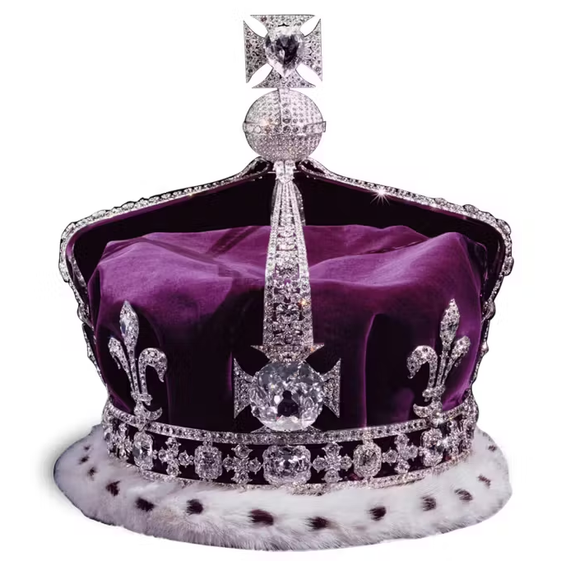
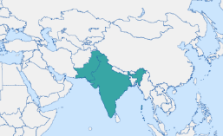
Lesson Planning Overview: The Koh-i-nûr diamond
Scholarship
Royal Collection Trust Website, text adapted from Victoria & Albert: Art & Love, London, 2010.​
Danielle Kinsey, “Koh-i-Noor: Empire, Diamonds, and the Performance of British Material Culture.” Journal of British Studies 48, no. 2 (2009): 391–419. ​
William Dalrymple and Anita Anand, Koh-i-noor: The Story of the World’s most infamous diamond (Bloomsbury 2017. Also subject of this episode on their Empire podcast.
The Crown Jewels Up Close | Tower of London | Historic Royal Palaces (hrp.org.uk)
Curriculum Themes
The Koh-i-nûr diamond helps explore:
Possession and ownership
Who do items belong to?
Commonwealth
Theft of objects and wealth
Changing role and presentation of objects for different ‘owners’.
Object biographies.
Crown’s role in sustaining Empire.
The Great Exhibition and the height of Empire.
Period & Place
The Koh-i-nûr diamond dates to the 1740s and is believed to have come from Persia.
Objects of Empire
Royal Collection Trust / © His Majesty King Charles III 2023
Object Summary:
The ‘Koh-i-nûr/Koh-i-noor’ was translated into English as ‘Mountain of Light’. The diamond has a long history and changed hands several times before it ultimately came into the possession of Ranjit Singh, Maharaja of the Sikh Empire in the Punjab. It was confiscated on behalf of British crown from Maharaja Duleep Singh in 1849 after the British annexed Punjab. A durbar or ceremonial meeting was organised by Dalhousie, Governor-General of India, where the defeated 12 year-old Maharaja was compelled ‘to offer the diamond directly to the queen, as a token of his submission’ (Kinsey).​
The celebrated diamond, set in an armlet, was delivered to Queen Victoria at Buckingham Palace on 3 July 1850. It was exhibited at the Great Exhibition in 1851 and recut afterwards.
After Queen Victoria's death the stone was mounted in the crowns of Queen Alexandra, Queen Mary and Queen Elizabeth (consort of George VI).
Lesson Ideas
Tracing histories of the object and who owned it various times.
Images of the object in its various guises and roles, e.g. crown and original form.
Who does it belong to? Examining who it has possessed it throughout its history.
Groups researching different aspect of the diamond’s past to reveal different aspects of colonialism and the history of Britain in India.
Plenary discussion of who it belongs to now and who it should belong to.
Sequencing & Pairing
Discussion of this object links to earlier teaching on the Mughal Empire and pre-colonial India, providing a thread of Indian history to link prior learning.
It could be useful for linking to diverse histories of Empire and Commonwealth. Examining the different crown jewels, and the story of the Coronation and Crown possessions could offer a great way to talk about how empire and possession of territories and precious objects was incorporated into the royal self-image.
Notes on teaching
These ideas were collated by the group on our ‘Teaching Empire through Material Culture’ HA course. Do let us know if you teaching with this object in the classroom!
Created by the ‘Teaching Empire through Material Culture’ Historical Association course group, led by
Dr Sarah Longair and Sasha Smith

