Slide 1
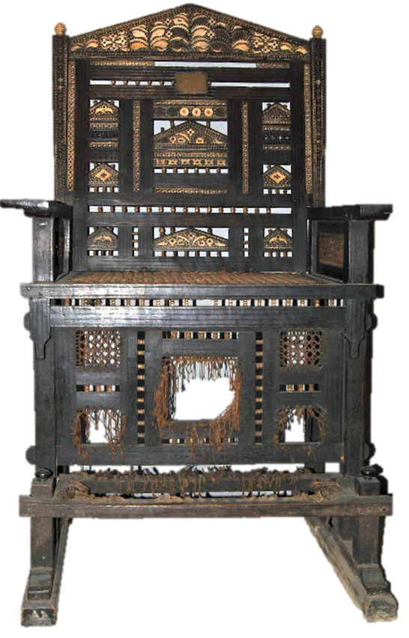
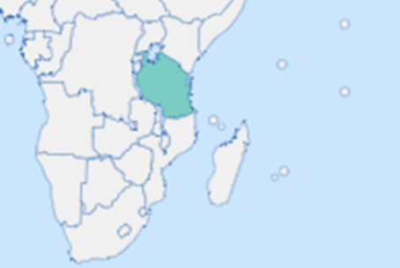
Lesson Planning Overview: Kiti Cha Enzi
Scholarship
This lesson is planned using Dr Sarah Longair’s chapter ‘Seats and Sites of Authority: British Colonial Collecting on the East African Coast’ in M. Kerr and M.Ingleby Coastal Cultures of the Long Nineteenth Century.
Useful links:
British Museum object details: https://www.britishmuseum.org/collection/object/E_Af1992-05-1
Alternative example - https://www.artic.edu/artworks/183077/chair-kiti-cha-enzi
Curriculum Themes
Kiti Cha Enzi helps explore:
East African kingdoms
Omani rule and sultanates.
Impacts of Omani rule on customs and practices in Zanzibar.
European trade and tourism.
Scramble for Africa.
Resistance to Omani, German and British rule by Swahili people.
Changing meaning of objects.
Imperial tourism and the creation of trade
Colonial rule of East Africa.
Power
Period & Place
Kitzi Cha Enzi originate from coastal East Africa and were used by the Swahili rulers of the 18th and 19th century.
Objects of Empire
Swahili kiti cha enzi (chair of power, Af1992,05.1 © The Trustees of the British Museum
Object Summary:
The kiti cha enzi, (singular:. viti vya enzi) meaning ‘chairs of power’ is a form of throne used by Swahili rulers in the eighteenth and nineteenth centuries. Their distinctive style is characterized by the ebony frame, twine webbing panels, intricate ivory inlay and footrest. While there are many standard viti vya enzi in museums, this example is distinctive in being significantly larger and even more elaborately decorated, but with some damage. The domination of the East African coast by Oman in the eighteenth century led to the decline of the use of thrones in the nineteenth century, as they were seen as a threat to Omani rule. Production continued for European markets during the Scramble for Africa. This chair was seized from the Sultan of Witu’s palace in 1890 when that region was forcibly brought until British control.
Lesson Overview
Getting started with the image of the chair. Developing with object investigation prompts. Discussing what thrones mean and symbolise.
Potted history of East Africa alongside considering who holds power at the time, and what the chair means. E.g. when the Omani Busaidi family try to minimise use of the chair, it’s because it is a symbol of East African power they’re trying to diminish.
The story of the Sultan of Witu’s chair, narrative.
What can the story of the Sultan of Witu’s kiti cha enzi teach us about… East Africa? The British Empire? Colonisation of Africa/the scramble for Africa?
How can museums reflect the importance of these items? How should it be exhibited in the British Museum?
Sequencing & Pairing
The primary focus of this lesson is the changing powers in coastal East Africa and the way imperialism led to countries changing hands. This lesson is therefore paired with lessons on power and symbols of power. It can be sequenced with symbols of power such as royal thrones and crown jewels,. It can also sit alongside an enquiry into the Scramble for Africa. We will link back to this lesson when examining the pre-WW1 tension over colonisation in Africa. It would also work well for a depth study of the British Empire in Africa. The lesson can also pick up on themes of resistance and colonised voices through the enduring symbolism of the chair.
Notes on teaching…
This lesson was planned for KS3 Year 8 students. The enquiry that asks ‘How can material objects help us to understand Britain's role in the world?’ This lesson helps tie in prior learning about African Kingdoms, as well as supporting students developing a better understanding of the vastness and differences between African countries. The theme of power is explored through thrones.
By Sasha Smith (@SashaL_Smith)
For the Objects of Empire Project,
supported by The University of Lincoln

