Slide 1
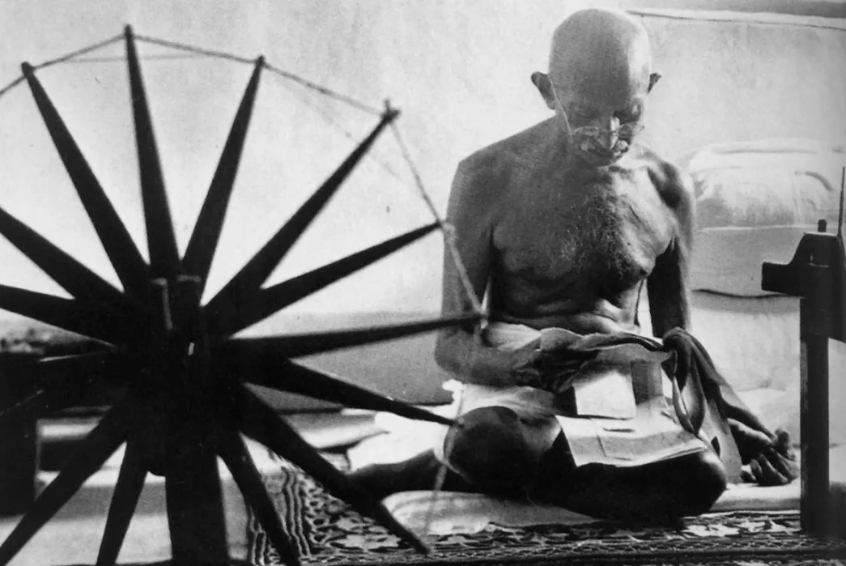
What can khadi teach us about the British Empire?
Last lesson we learnt about… the 1857 Indian Mutiny.
Big Picture: How can material objects help us to understand Britain's role in the world?

Slide 2
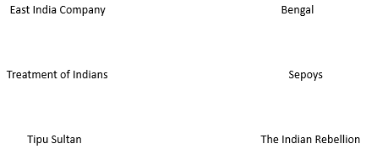
STARTER
What do we already know about the relationship between Britain and India? Let’s review what we’ve learnt so far by using the following prompts to explain their history.

Slide 3
What can khadi teach us about the British Empire?
Discussion: What do we mean by resistance? Why might India have resisted British rule?
Task: Why did indigo dye and khadi cloth become an important part of the relationship between Britain and India?
We are going to watch a video on the indigo trade in the British Empire in India, Gandhi, and khadi cloth.
Watch closely, and when we pause, add your notes to the image of Gandhi and the spinning wheel.
https://youtu.be/ArtFccO_kBw
Notes:
PAUSE TO HELP STUDENTS COMPLETE THIS.

Slide 4
What can khadi teach us about the British Empire?
Discussion: Why did Khadi cloth become a symbol of resistance?
Discuss with your partner and be prepared to share your answer with the class.
Remember to use your knowledge of the topic to explain your answer fully.
https://youtu.be/ArtFccO_kBw

Slide 5

What can khadi teach us about the British Empire?
Highlighting the causes of Indian resistance, forms of resistance, and impacts of resistance.
The swadeshi (home) movement of the 1890s was a response to a growing discontent with the colonial government in India. Economic issues were at the heart of the problem, particularly the influx of large quantities of foreign goods into India. Machine made thread and fabric from England was cheaper and finer and its importation was disrupting India’s own production of handmade fabric and the development of her textile mill industry. The movement called for the Indian public to boycott foreign goods in favour of Indian products and led to mass protests and bonfires of foreign clothing. The swadeshi message of self-reliance influenced Mohandas Gandhi in his formation of the freedom movement some fifteen years later.
The Spinning Wheel of Democracy
By Divia Patel,
Senior Curator at the V&A.

Slide 6
The swadeshi (home) movement of the 1890s was a response to a growing discontent with the colonial government in India. Economic issues were at the heart of the problem, particularly the influx of large quantities of foreign goods into India. Machine made thread and fabric from England was cheaper and finer and its importation was disrupting India’s own production of handmade fabric and the development of her textile mill industry. The movement called for the Indian public to boycott foreign goods in favour of Indian products and led to mass protests and bonfires of foreign clothing. The swadeshi message of self-reliance influenced Mohandas Gandhi in his formation of the freedom movement some fifteen years later.
Gandhi asked the nation to spin, weave and wear khadi. He believed that this would bring employment to the poor of India who were based mainly in villages. He led by example, spinning for part of each day and wearing the simplest of khadi clothing. His campaign of civil disobedience against unjust laws and the need for swaraj (self-rule) for the Indian people used the symbolism of khadi to gain momentum. As the movement grew, the sight of Gandhi and his sea of supporters in white khadi was a powerful tool of protest. In the exhibition we will have fantastic film footage of the period which captures the great crowds that gathered to hear Gandhi speak and shows how central khadi was to the movement.
Notes:
FULL VERSION OVER TWO SLIDES IF NEEDED

Slide 7
One of the most distinct items of clothing at the time was a white khadi cap which came to be known as a Gandhi cap. Gandhi was aware of the visual symbolism of the cap and he wrote: ‘thousands will be prepared to die for the khadi cap which is fast becoming a visible mark of swadeshi and swaraj’”.
Khadi and the message of self-reliance that it embodied was important to the Indian National Congress, the main party opposing British rule, of which Gandhi was appointed leader in 1921. The party placed the spinning wheel at the centre of their flag. The illustration above shows the flag and cap – it is the front cover of a publicity booklet for the 1955 film, Shaheed. The road to independence was a long one and over time there was a redesign of the flag with the use of different colours. When freedom from British rule was finally achieved in 1947, the spinning wheel was replaced by the wheel of law. It continues to be made of khadi.

Slide 8

What can khadi teach us about the British Empire?
We are going to look at a range of key words that will acts as prompts to review our learning. On your whiteboard, explain how the word links to the British Empire and India.
Environment
Passive Resistance
Leadership
Independence
Symbol
Class modelled:
Resistance
Notes:
Model one. Then students write their own. Then review to tease out further nuance. You can write your own words on the board.

Slide 9
PLENARY
Why was there resistance to the British Empire in India?
Because…………………………………………………………………………………………………………………………………………………………………………………………………………………………………………………………………………………………………………………………………………………………………………………………………………………………………………
But…………………………………………………………………………………………………………………………………………………………………………………………………………………………………………………………………………………………………………………………………………………………………………………………………………………………………………………
So……………………………………………………………………………………………………………………………………………………………………………………………………………………………………………………………………………………………………………………………………………………………
Include the following:
The East India Company 1600s
Tipu and Mysore
Attack on Seringapatam (Tipu)
Sepoy army
Indian Mutiny 1857
Treatment of indigo farmers
Swadeshi Movement
Khadi Cloth
Gandhi
Notes:
Prompts in chronological order to help students. Loosely, it should cover TAKING OF INDIA, CRUSHING OF RESISTANCE, KHADI AND RESISTANCE.

Slide 10
See notes on Khadi cloth from CPD session
Khadi cloth is in the cupboard in C220 for use.

