Slide 1
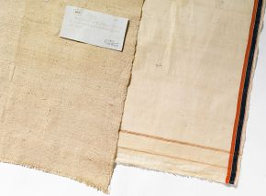
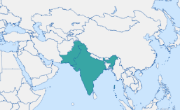
Lesson Planning Overview: Khadi Cloth
Scholarship
This lesson was planned using:
The Spinning Wheel of Democracy, by Divia Patel, Senior Curator at the V&A (V&A Blog article)
https://www.vam.ac.uk/blog/fabric-of-india/the-spinning-wheel-of-democracy
See also Lisa Trivedi, Clothing Gandhi’s nation: homespun and modern India
Further reading and links:
The Fabric of India: Textiles in a Changing World - Victoria and Albert Museum (vam.ac.uk)
Curriculum Themes
This object helps explore:
Colonial rule
Resistance to British rule
Passive resistance
Leadership of resistance
Trade
Environmental impact of British rule (indigo farming)
Symbols of resistance
Indian independence
Legacy of Empire
Types of objects/exhibitions
Period & Place
The Swadeshi home movement because in the 1890s in India as a form of resistance to the British Raj.
Objects of Empire
Lengths of khadi (detail), plain-woven cotton, Gujarat, India, about 1867. Museum nos. 0120 (IS), 5955 (IS), © Victoria and Albert Museum
Object Summary:
British exploitation of India’s economy and people led to the swadeshi (‘own country’) movement of the 1890s. Swadeshi urged the nation to boycott foreign goods and buy Indian products. The principle of self-reliance influenced the nationalist leader Mohandas Gandhi in his call for swaraj (‘self-rule’). Gandhi appealed to the Indian people to spin, weave and wear khadi – a fabric hand-woven from hand-spun cotton thread. He believed this would undermine reliance on imported goods, increase self-sufficiency and alleviate poverty. In 1921, Indian nationalists adopted khadi cloth as a symbol of resistance and incorporated the spinning wheel into the design of their flag.
Lesson Ideas
What do we already know about the relationship between Britain and India? Retrieval with prompts.
Discussion: What do we mean by resistance? Why might India have resisted British rule?
Video clip about indigo farming and the early swadeshi movement.
Discussion: Why did Khadi cloth become a symbol of resistance?
Guided reading of The Spinning Wheel of Democracy, by Divia Patel.Highlighting the causes of Indian resistance, forms of resistance, and impacts of resistance.
Whiteboard key word prompts to link khadi cloth to the wider context of empire.
Why was there resistance to British rule? Because/but/so with prompts.
Sequencing & Pairing
The Swadeshi movement and khadi cloth help teach about resistance, so would pair well with an enquiry into resistance to British rule. As such, it would also pair well with lessons that give space for indigenous voices and leadership of movements against the British Empire. It also pairs well with lessons that consider symbols and the types of objects that have value in telling the story of Empire.
In our enquiry, this lesson forms part of a sequence of lessons into the British Empire in India. It build on prior learning about the Mughal Empire & Indian kingdoms prior to EIC trade, the Anglo-Mysore wars & Seringapatam, and the Indian Rebellion. It links to future lessons on the partition of India.
Notes on teaching…
This lesson was planned for KS3 Year 8 students. The enquiry that asks ‘How can material objects help us to understand Britain's role in the world?’.
We use lengths of actual khadi cloth in the lesson as a way to bring the object into the classroom. This was done the second year of teaching the enquiry and having the material in the classroom really elevated the lesson for students.
By Sasha Smith (@SashaL_Smith)
For the Objects of Empire Project,
supported by The University of Lincoln

