Slide 1
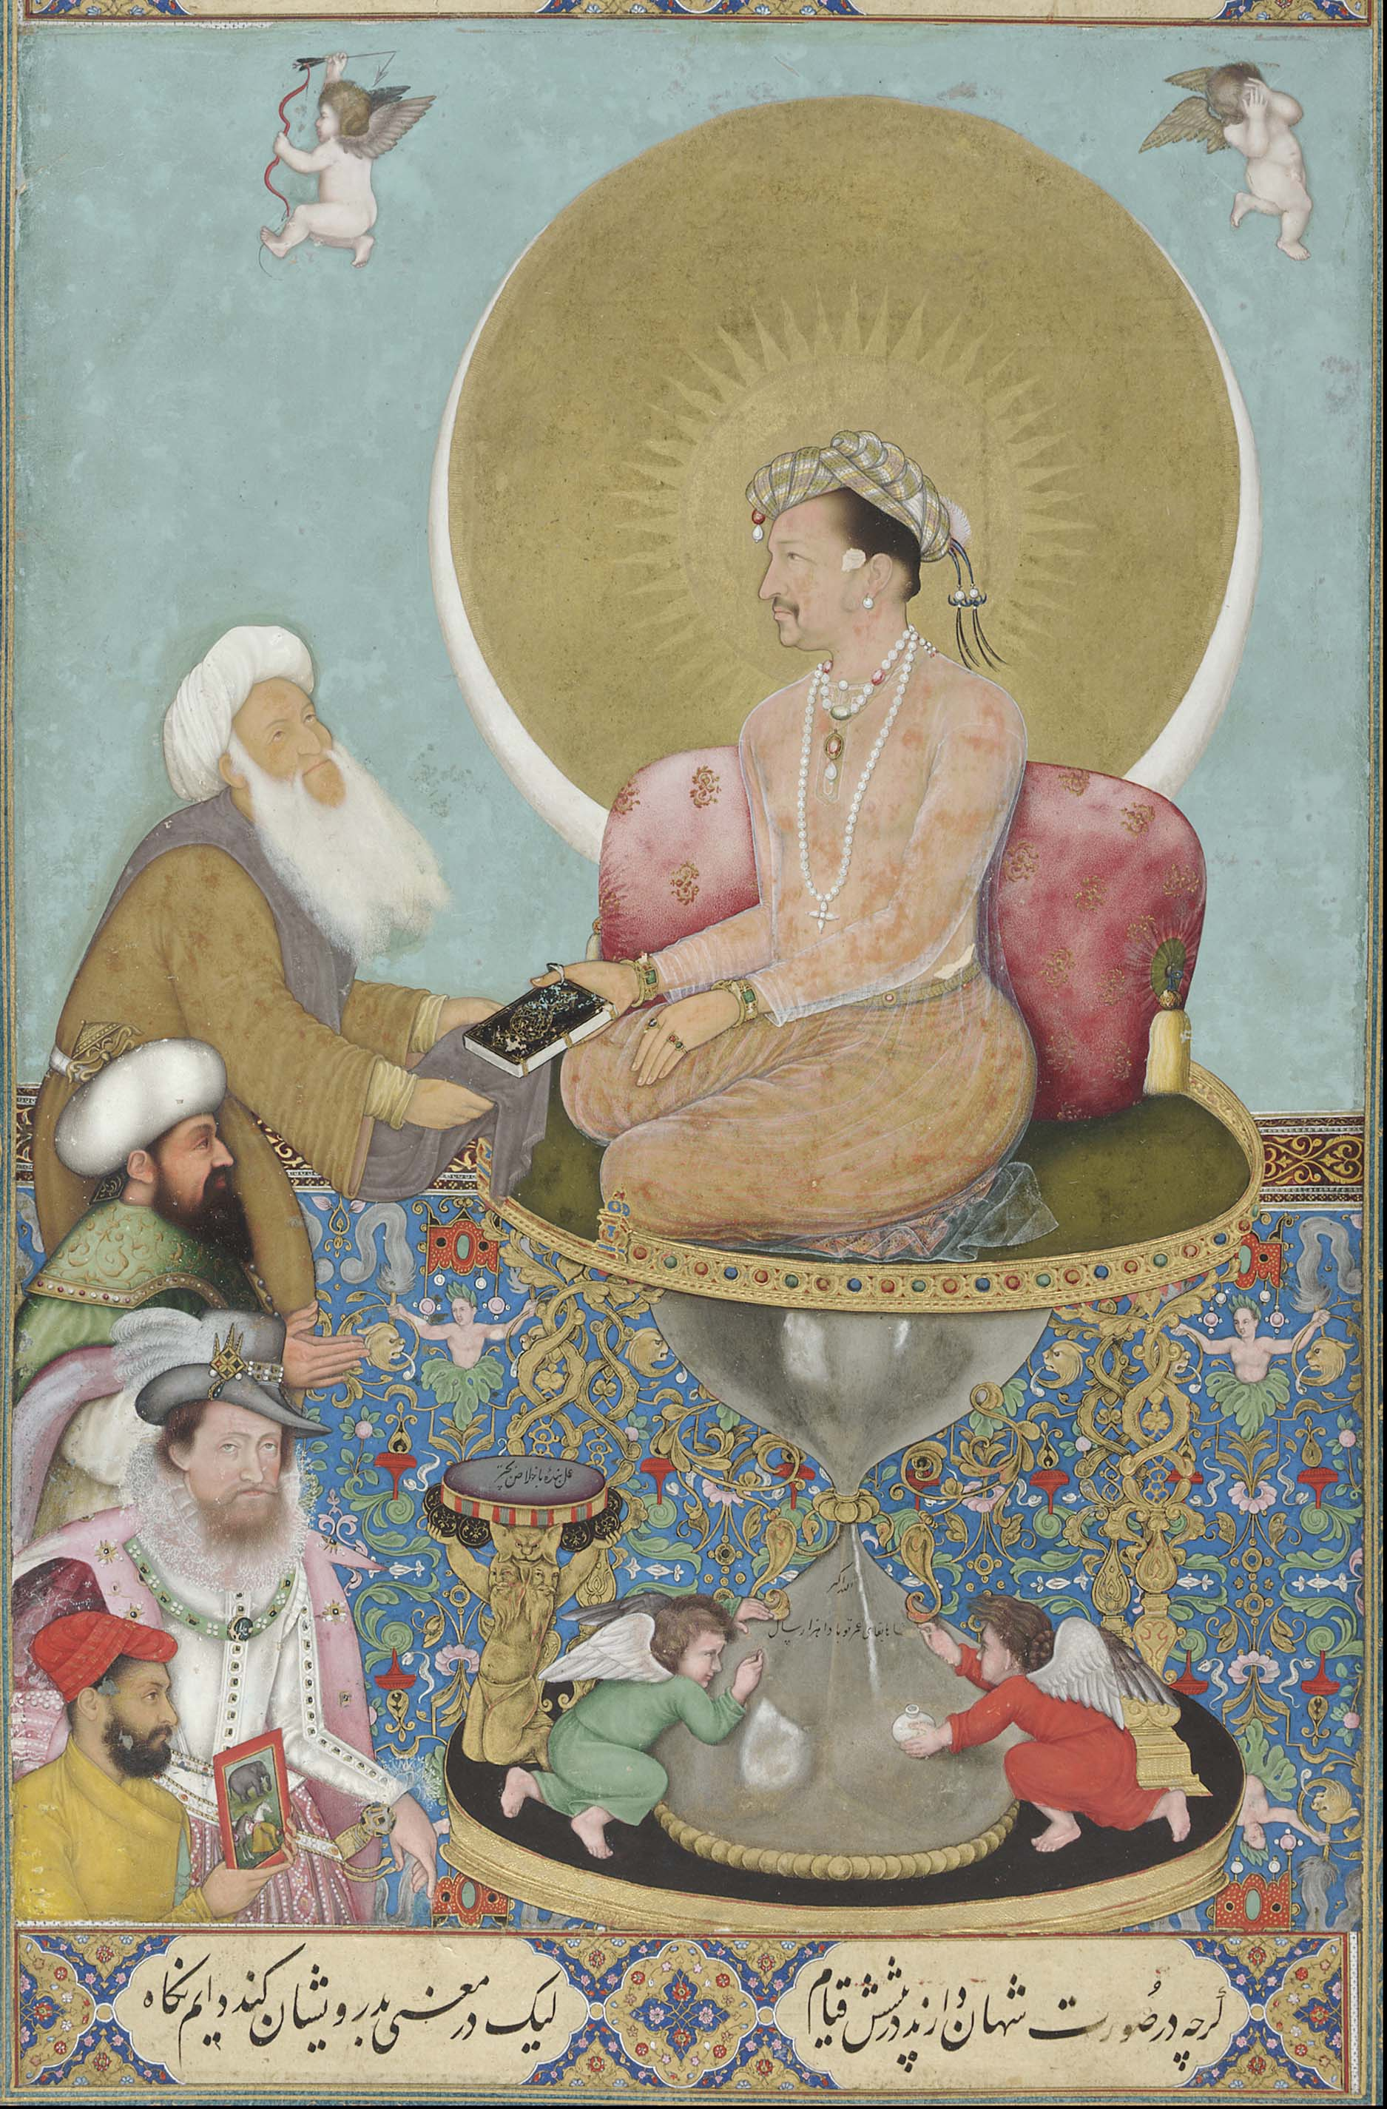
Objects of Empire: Jahangir Painting
What can paintings reveal about the power of the East India Company?

Slide 2
What can paintings reveal about the power of the East India Company?
DO IT NOW! Answer the following questions:
What is an Empire?
What is a Colony?
Give THREE reasons why England wanted to expand its overseas empire.
KNOWLEDGE ORGANISER CHECK: Give THREE examples of goods/resources from India that the East India Company traded in.
KNOWLEDGE ORGANISER CHECK: When was the Battle of Plassey?
Areas of land/collection of countries/groups of peoples taken over and controlled by another country.
An area of land under the control of another country.
More power/ competition with other countries/ access to natural resources/ increase trade/ idea that white people were more ‘civilised’ than other races/ revenge/ war/ religious missionaries
Spices/ silks/ tea/ textiles/ opium/ cotton/ indigo dye
1757

Slide 3
British Empire in India… The Big Picture
India and the British Empire
Introduction to Empire
The East India Company
Tipu Sultan’s rebellion
1857 Indian Mutiny/ Rebellion
Impacts of British Rule
The Amritsar Massacre
Learning intentions
Today we are learning to…
Understand how the East India Company was able to establish English control over India.
Links to the KEY CONCEPTS
Economics: the EIC was initially set up to increase English trade in the area.
Individuals: Robert Clive was a key individual in establishing British control in India.
Historical skills: we will be examining a series of primary sources, including paintings and artefacts, and analysing what they reveal about the power of the EIC.

Slide 4
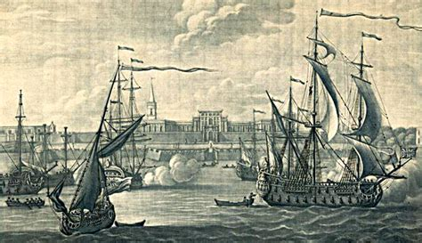
What was the East India Company (EIC)?
Queen Elizabeth I founded the East India Company in 1600.
Its first aim was to increase English trade in exotic goods and spices like nutmeg, cinnamon, pepper and cardamom. These would be obtained from the East Indies, in places like Indonesia and Malaysia.
England was late to this race! Portugal and the Dutch East India Company had already obtained a lot of control and power in the region, and England was unable to set up trading posts in the East Indies. This meant the English EIC had to look to India to try and capture important markets.
SUMMARY TASK: Break down the text into the following sentences
The East India Company was founded in… by…
Originally its first aim was to…
However, it faced stiff competition from…
This meant it needed to…

Slide 5
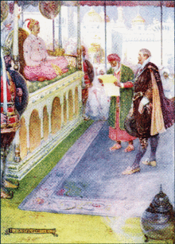
The early days…
The East India Company was a joint-stock company, which meant lots of ordinary workers, and businessmen, if they had the money, could invest in the EIC and claim a share of its profits.
It wasn’t plain sailing! The first fleet of the EIC, between 1601 and 1603, had a fatality rate of over 60 per cent!
Slowly, the EIC began making money trading in goods from India, and set up its first Indian trading post in Surat in 1612.
Sir Thomas Roe (1581-1644) was the Ambassador of the EIC to the Mughal Empire, which was in charge of India at the time.
Roe was able to get the Mughal Emperor Jahangir to offer protection to the EIC’s post in Surat, and to give special treatment to the EIC like lower taxes.
CHECK FOR UNDERSTANDING!
What is a joint-stock company?
When and where did the EIC set up its first trading post?
Who was Sir Thomas Roe?
What did he get Mughal Emperor Jahangir to do?

Slide 6
Source inference
This is a painting called ‘Jahangir preferring a Sufi Shaikh to Kings’ from c.1618.
What can you see? What do you think the main message is?

Slide 7
Source inference
This is a painting called ‘Jahangir preferring a Sufi Shaikh to Kings’ from c.1618.
What can you see? What do you think the main message is?

Slide 8
Source inference
This is a painting called ‘Jahangir preferring a Sufi Shaikh to Kings’ from 1618.
What can you see? What do you think the main message is?

Slide 9
Source inference
Did you spot the Sufi Shaikh? It’s the man giving a holy book to the Mughal Emperor.
This man is the Ottoman Emperor, Sultan Osman II.
Did you spot King James I of England?
Why is an English King here?
Can it suggest that the Mughal Empire was keen to increase its trading relationship with England?
OR… is the fact that the Emperor is keener on learning about the Islamic religion than receiving foreign kings suggesting that England had a lot more work to do to increase its power and influence in India?

Slide 10
Paintings and the EIC
We are going to examine a sequence of different paintings which chart the changing power and influence of the EIC in India over the next century and a half in India.
Study each painting carefully, and take brief bullet-point notes on the following:
What can you see?
Who might be in the painting?
What does it suggest about the power of the EIC?
What can we learn about Indian attitudes towards the EIC?
STRETCH AND CHALLENGE: Who might have commissioned the painting and why was it made?

Slide 11
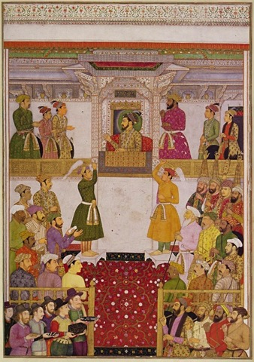
Paintings and the EIC
This is a painting by an unknown artist from around 1650. It is now in a collection in Windsor Castle.
It is called ‘Europeans bring gifts for Shah Jahan.’
REFLECT… Did you spot the Mughal Emperor, Shah Jahan?
Who are the people surrounding him?
Did you spot the European traders in the bottom-left corner? What are they doing?
CHALLENGE MR. ASPIN! DO YOU DISAGREE?
This painting shows that the EIC is still very much just trying to trade with the Mughals in India, and doesn’t really have much power or influence at all by 1650.

Slide 12
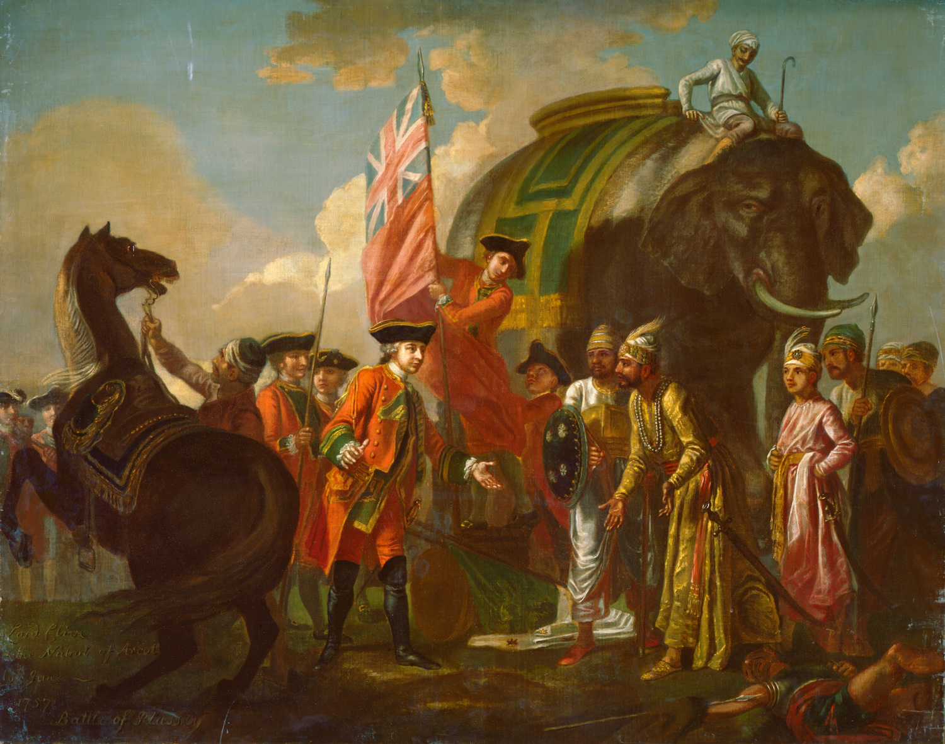
Paintings and the EIC
This painting would be used following direct teaching about the Battle of Plassey/Clive.
REFLECT… Can you work out what is happening here?
Who is the man in the red coat?
What does the flag imply?
What is the purpose of the Indian princes (Nawabs) in the painting?
What can we learn about the relationship between the EIC and the Indian people?

Slide 13
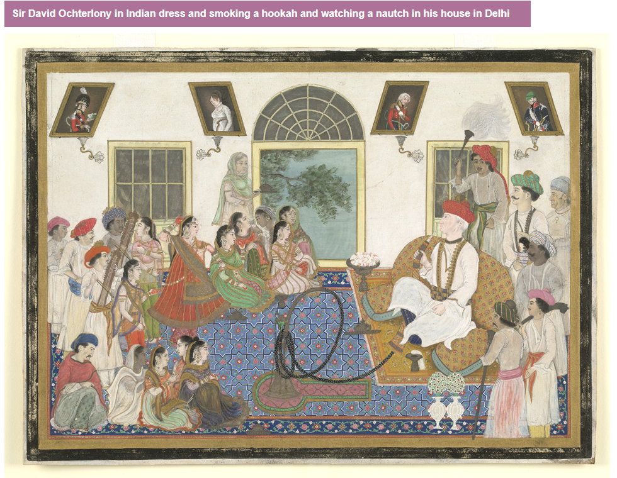
Paintings and the EIC
This anonymous watercolour from about 1820 shows an East India Company officer, dressed in Indian clothing, smoking a Hookah pipe.
CAN YOU SPOT… The EIC officer? The Hookah Pipe?
Who are the people surrounding him?
What impression of the EIC does the painting show?
Overall, what can we learn about the EIC and their power over India?

