Slide 1
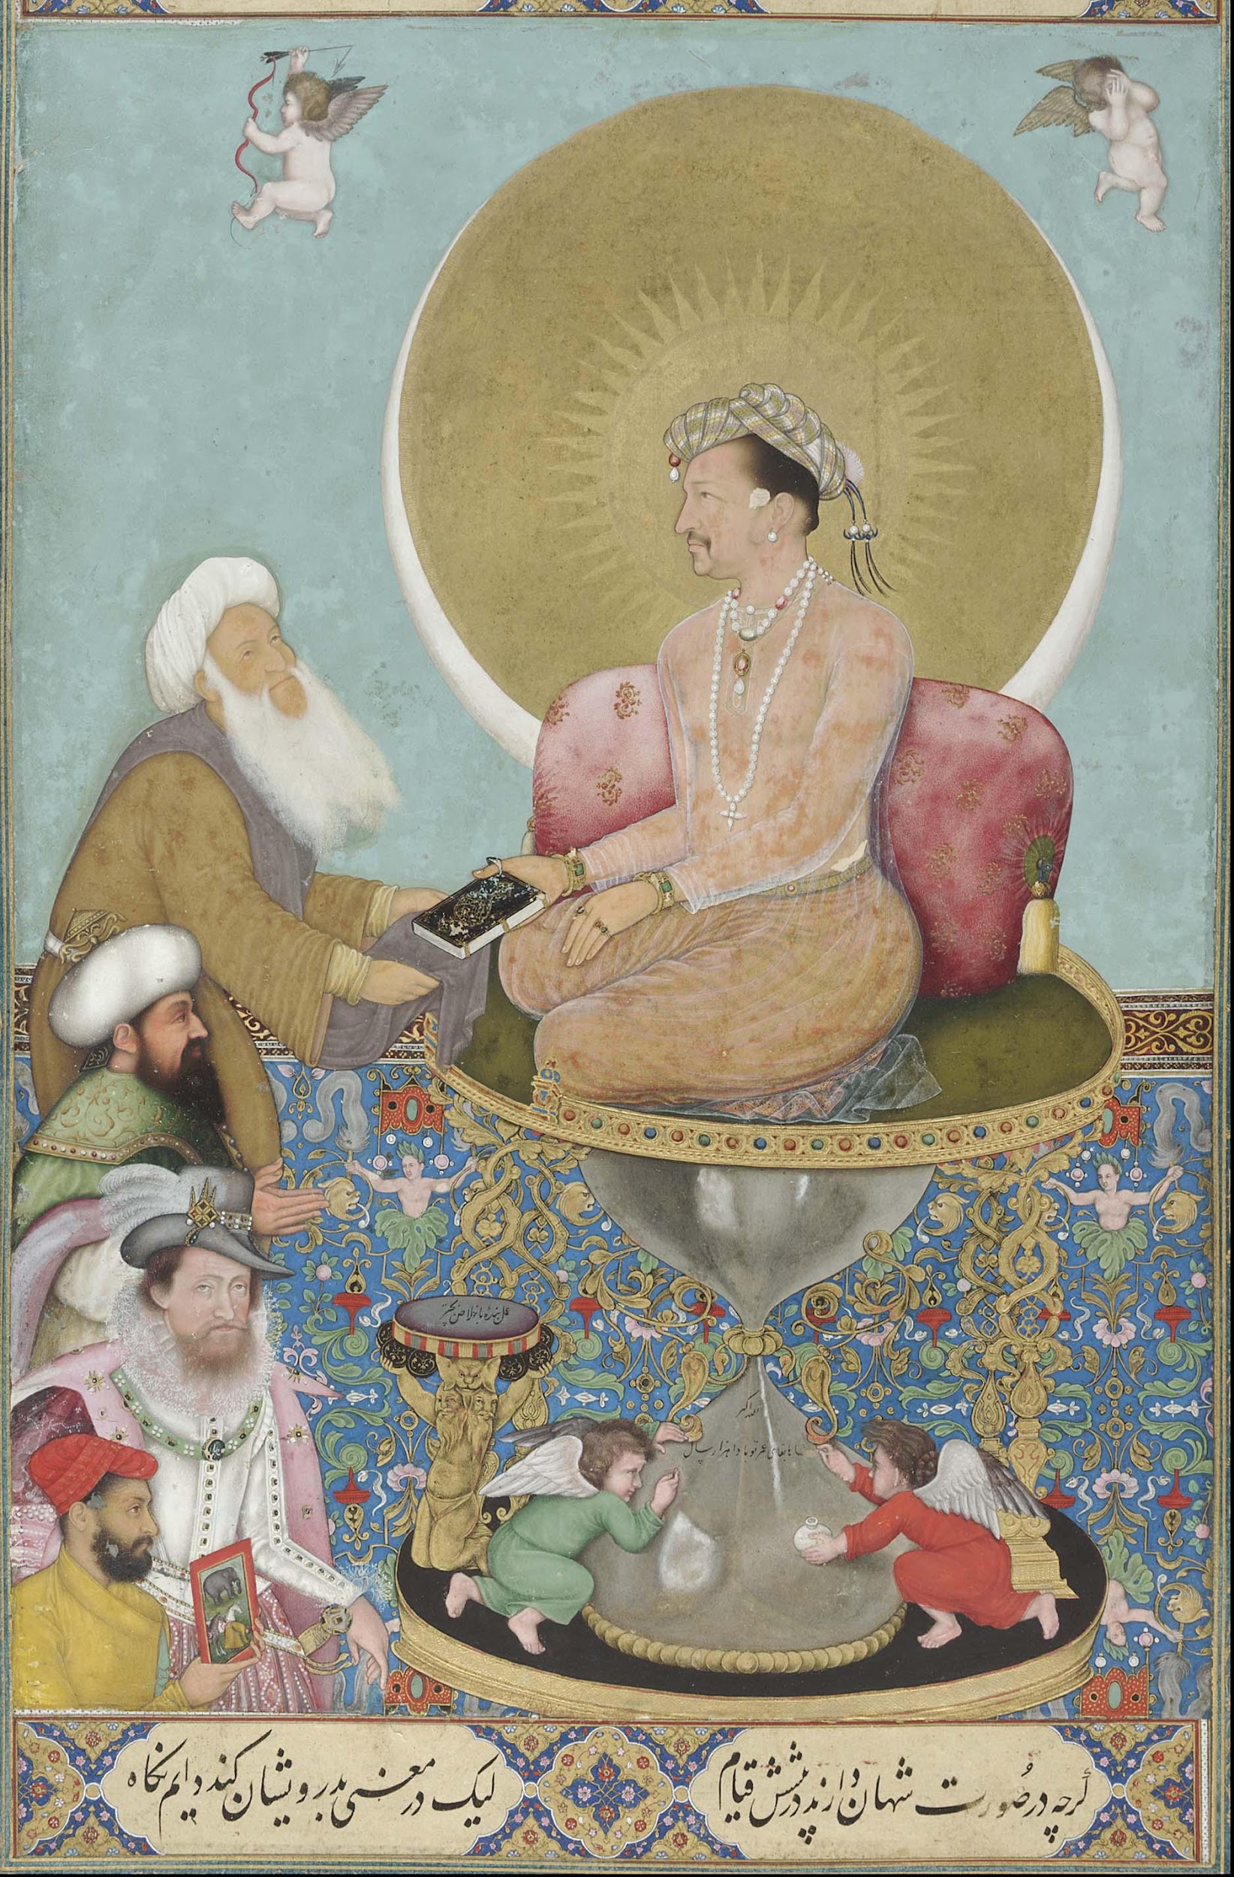
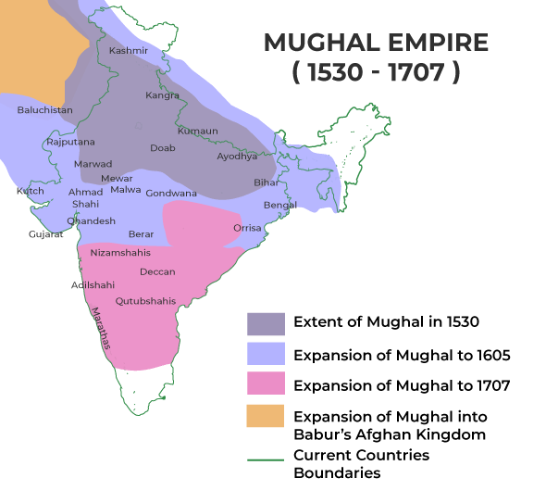

Lesson Planning Overview: Bichitr miniature of Mughal Emperor Jahangir
Scholarship
‘Bichitr, Jahangir Preferring a Sufi Shaikh to Kings’ by Roshna Kapadia
https://smarthistory.org/bichtir-jahangir-preferring-a-sufi-shaikh-to-kings/
Dr. Mark Williams, The East India Company and Empire: Foundations and Memory; Historical Association Virtual Branch Lecture, February 2024
Das, Nandini, Courting India: England, Mughal India and the Origins of Empire
Curriculum Themes
Links to the KS3 National Curriculum theme of Ideas, Political Power, Industry and Empire.
Also useful for the AQA Migration, Empires and the People GCSE unit.
Relevant themes and concepts: empire, colony, colonisation, diplomacy, monarchy, trade, joint-stock company, political power.
Period & Place
The painting comes from the time when the Mughal Empire was expanding across northern India. Jahangir was the 4th emperor, reigning 1605 – 1627
Objects of Empire
Lesson Ideas
Useful as a discussion exercise during a lesson about the early rise of the EIC.
Students could be given the painting ‘blind’ and be asked to annotate what they see, before considering why the painting has been commissioned and what its main message is.
Ask students what the painting reveals about the position, power and status of the EIC in the 1610s.
Juxtapose this painting with ‘English’ paintings, showing a very different power dynamic, like Clive receiving Mir Jafar or signing the Treaty of Allahabad. It shows different stages of EIC control.
Sequencing & Pairing
Overall enquiry idea – How and why did Indians resist and rebel against British rule?
This is intended to be used as the first of a series of paintings and artefacts to plot the rise and decline of the EIC over 200 years, finalising with students being assessed by which four/five objects or paintings they would choose to best re-tell the story of the EIC and Indian resistance.
Juxtaposing this with other paintings will present students with contrasting interpretations about the power and influence of the British Empire in India over time.
Notes on teaching…
This painting reveals a lot about the early East India Company and its relations with the Mughal Empire. It was an age when England was clearly trying to improve trading relations and acquire more power and influence in the region. The inclusion of King James I in a distinctly Mughal painting raises interesting classroom discussions about power dynamics, influence and how England was regarded by other powers. The fact that James I is third-in-line, behind the Ottoman Emperor and a holy man, has connotations of England being a ‘supplicant’. England is slowly gaining influence, but has a lot more to do. It is good in the classroom to challenge
the view that England was quick
to become the dominant power on
the subcontinent. Students can have
stimulating and insightful discussions!
‘Jahangir preferring a Sufi Shaikh to Kings’, Bichitr, Mughal artist, miniature c.1615-18, National Museum of Asian Art, Smithsonian, Washington, D.C.
Object Summary:
This is a revealing miniature painting from the 1610s, which shows the Mughal Emperor Jahangir receiving a gift of a holy book from a Sufi Shaikh. We see lots of religious iconography, including halos and angels and an intriguing hourglass which serves as the Emperor’s seat. Crucially, at a time when the East India Company’s Sir Thomas Roe had just been appointed as the Company’s first Ambassador to the Mughal Court, King James I is clearly seen in a ‘queue’ to be received by Jahangir, following the Shaikh and the Ottoman Emperor, and artist Bichitr himself.
Created by the Michael Aspin for the ‘Teaching Empire through Material Culture’ Historical Association course group

