Slide 1
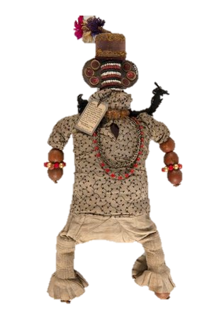
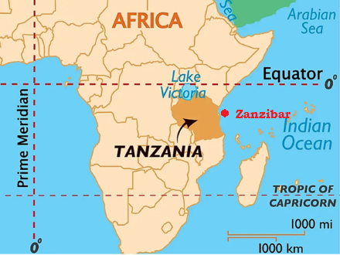
Lesson Planning Overview: Sanamu Fertility Doll
Scholarship
This lesson is planned using Sarah Longair, Island Collecting: Objects and Empire in the Indian Ocean, 1850 - 1930, forthcoming 2026.
Curriculum Themes
This object helps explore:
Trade
Missionary work
Power dynamics
Economic dynamics
Symbols and objects of cultural significance to individuals and within East African cultures.
Period & Place
The sanamu originates from Zanzibar an archipelago, part of present-day Tanzania and was acquired c. 1900-1916.
Objects of Empire
Sanamu or Fertility doll from Migombani, Unguja, Zanzibar, ©Pitt Rivers Museum, University of Oxford.
Lesson Overview
Getting started by annotating an image of the sanamu without context. Degree and timing of scaffolding dependent on the class. Students to glean that the object is precious to someone.
Context of fertility dolls – teacher talk.
Looking at where the object is now, and linking to prior learning about paths to museums. What is missionary work?
Source analysis of Josephine Chaveaux’s letter. What can her letter reveal about:
The sanamu
Relations between the British and Zanzibari
Missionary work and women in empire
The agency of the owner
5. Examining the letter for other objects and purpose of collection.
6. What does the sanamu teach us about Empire?
Sequencing & Pairing
The primary focus of this lesson is the dynamic between coloniser and colonised women. The object helps us to explore the way power dynamics existed and intersected with gender. Alongside this, we look at the role of missionaries and the power balances that still existed there.
This could be paired with a depth study of East Africa through coco-de-mer and the kiti cha enzi, all of which look a the power of the coloniser and the resistance and agency of local peoples. This could tie in with prior learning about African kingdoms.
The lesson could also tie in with a study of women in empire, a study of personal belongings of ‘ordinary people’, or an enquiry that looked at empire through trade.
Object Summary:
This sanamu or fertility doll from Zanzibar was made from a core of fabric with gourds for arms and feet. It wears a shirt of imported cotton and trousers with frills at the base, known as marinda, similar to those worn by elite Zanzibari women in the late nineteenth and early twentieth century. The sanamu has three necklaces and three ear plugs in each ear, with woollen plaits and cap. Its design resembles some fertility dolls from the East African mainland, also made from gourds and adorned with beads. While mainland influence is common in Zanzibar (e.g. enslaved Africans were captured and brought to the islands; more recent voluntary migrants) the sanamu can be described as distinctively Zanzibari, particularly through the trousers and shirt, and its varied influences.It was acquired after Zanzibar had become a British protectorate by a female missionary, Josephine Choveaux, who reported having to forcefully persuade its owner to part with it..
Notes on teaching…
This lesson was planned for KS3 Year 8 students. The enquiry that asks ‘How can material objects help us to understand Britain's role in the world?’
This lesson is included to reveal more about the lives of women in and of the Empire, as well as the role of missionary work and power dynamics.
By Sasha Smith (@SashaL_Smith)
For the Objects of Empire Project,
supported by The University of Lincoln

